Slide 1
Copyrights-Unlocking the mystery
EAF 401

Slide 2
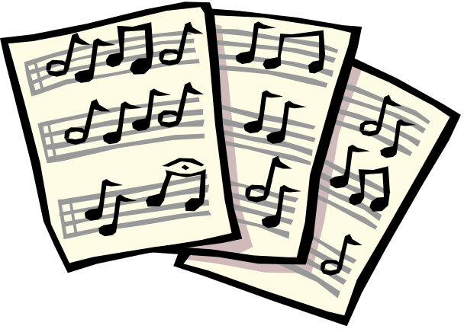

A definition of copyrights
A copyright is defined as a form of protection provided by the laws of the United States to the authors of “original works of authorship,” including literary, dramatic, musical, artistic, and certain other intellectual works.

Slide 3
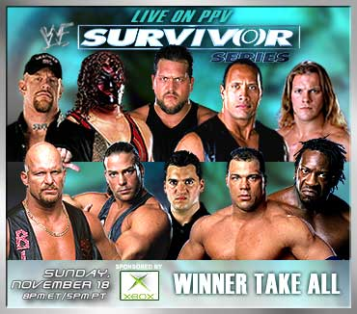

What copyrights protect
Poetry
Computer programs
Artwork
Music-written or recorded
Animations
Movies and Videos
Photographs
A web-page
And many more…

Slide 4
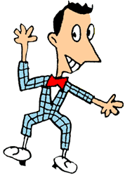
What copyrights don’t protect
Ideas
Titles
Short phrases
Logos/Slogans (trademark)
URL’s (link to a website)
Common works with no original author
-standard calendar
-rulers
-height/weight charts

Slide 5
Special Rules of works in the public domain
If created before, but not published before 1978, special rules apply:
  If created and 1st published between 1950 and 1978, the copyright lasts 75 years
  For works created and 1st published before 1950, the copyright last 28 years, but could have been renewed for another 28 years

Slide 6


When does someone obtain copyrights?
Copyrights are secured automatically when the work is created.
A work is created when it is first seen or heard.

Slide 7
The Notice of Copyrights
Copyright notice is not required, but is still relevant to the status of a copyright.
WHY??
Informs public the work is protected.
Identifies copyright owner.
Shows year of first publication.
Can be used in court to defend a work that has been used illegally.

Slide 8

How to register for copyrights
Send 3 items
1. Application form
2. Non-refundable
filing fee=$30
3. Non-returnable
copy of work
Send to:
Library of Congress
Copyright Office
101 Independence Ave.
Washington, D.C. 20559

Slide 9
Copyright Rights
RIGHT TO…
Reproduce or copy the work.
Produce new work from the original.
Distribute copies of work to public.
Perform work in public.
Display work in public.

Slide 10
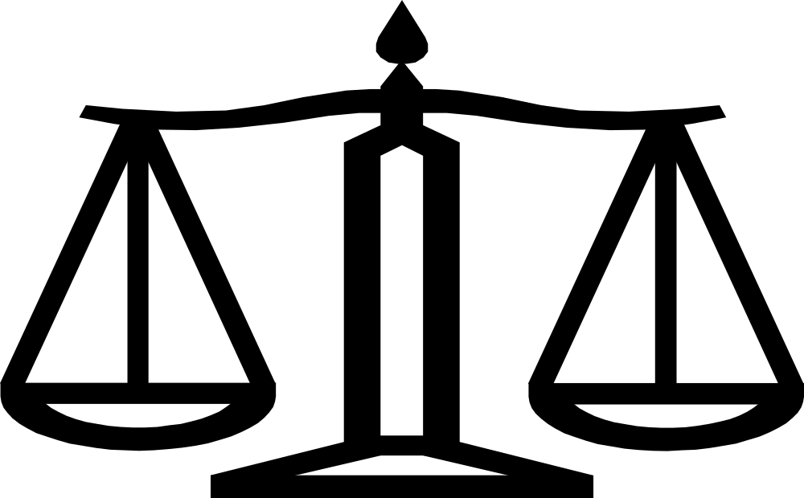
FAIR USE

Slide 11
Fair Use
Need to balance rights of copyright holders with society’s need to make copies in some cases.
We are able to use copyrighted work in certain cases because of FAIR USE.

Slide 12
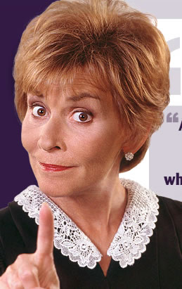
The Four Parts of Fair Use
PURPOSE
NATURE
AMOUNT
EFFECT

Slide 13

PURPOSE
Why are you using the material?
a. profit/non-profit
b. educational setting

Slide 14


NATURE
Published vs Unpublished
Factual vs Fiction

Slide 15



AMOUNT
Small versus Large portion of work
Significance of portion to whole
Appropriateness of portion

Slide 16
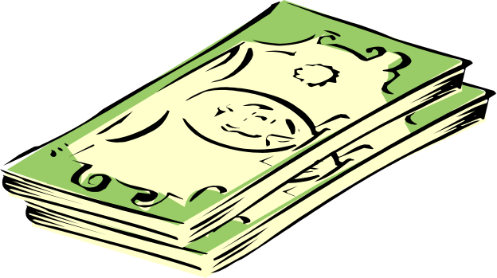
EFFECT
Will using the work positively or negatively affect the buying, selling, or viewing of the work?
Few vs Multiple copies

Slide 17
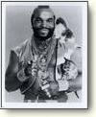
So you think you know copyrights?
TAKE THE COPYRIGHT BAY CHALLENGE!!
www.stfrancis.edu/cid/copyrightbay/cruises.htm

Slide 18
How do I reference the copyright owner of digital works?
Make sure the copyright symbol (“Copyright” or “©”) and the name of the copyright owner is attached directly on, under, or around the digital work.
It should be clearly visible
Copyrighted images, graphics, video, sounds, and written material must always be referenced

Slide 19
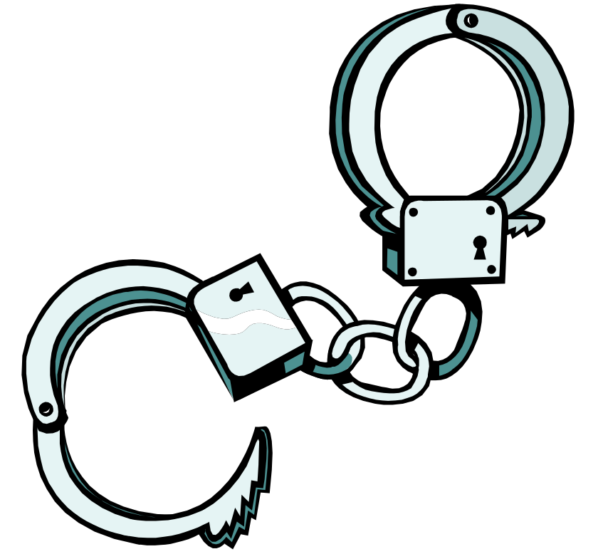
Copyright Violation
Civil vs Criminal Law.
Most likely punishment=
lawsuit
Least likely=Jail

